Slide 1
Basic Steering Behaviours
Seek, Arrive, Wander, Align form the basic behaviour set
They do one thing
Other behaviours built on top of these
Delegation!

Slide 2
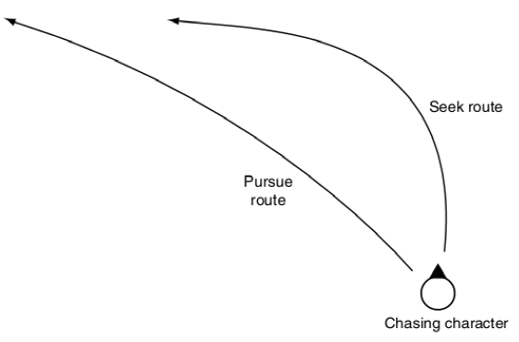
Pursue and Evade
When chasing a target it is sometimes best to aim not where the target is but where it is going
An intercept course
Calculate where it will be when we arrive
aim for that spot
use seek to new location
We need to be able to predict where it will be

Slide 3
Pursue
class Pursue:
…
def getSteering()
direction = target.position - my.position
distance = direction.length
speed = my.velocity.length
if speed <= distance / maxTimePrediction:
timePrediction = maxTimeprediction
else:
timePrediction = distance/speed
newtarget.position = target.position +
target.velocity * timePrediction
return seek(me, newTarget)

Slide 4
Issues?
We can overshoot if we move faster than target
Use arrive instead of seek
We can run ahead of target
Looking out too far

Slide 5
Evade
same except use flee not seek!
return flee(me, newTarget)

Slide 6
Face Behaviour
Look towards target
Calculate the target orientation
Delegate to the align function to perform the rotation
direction = target.position - my.position
if direction.length = 0: skip
else:
newTarget = target
newTarget.Orientation = atan2(direction.y, direction.x)
align(newTarget)
Notes:
Tan(angle) = opp/adj = y/x
Therefore, angle = atan(y/x)
The atan function only returns values between –pi/2 and +pi/2 whereas atan2 can return values between –pi and +pi
Check out https://www.youtube.com/watch?v=hZ2CuusMyCM

Slide 7
Look where you go
look in direction of travel
if my.velocity = 0: skip
else:
target.orientation = atan2(my.velocity.y, my.velocity.x)
align(target)

